Slide 1
UPPER SIXTH ARTS
GEOGRAPHY
Lesson 13
Urban Regions: Millionaire Cities, Conurbations and Megalopolis
Notes:
Good morning, class, and welcome to our geography lesson. I am your geography teacher, Mr Kamdem. Today we are starting Lesson 13: Urban Regions: Millionaire Cities, Conurbations and Megalopolis.

Slide 2
CLASS INFO
Class, Chapter and Duration
Class | Upper Sixth Arts
Chapter | Module 5: Understanding and managing settlement dynamics across the world in general and Cameroon in particular
Duration | 2 periods (2 × 50 minutes)
Notes:
This lesson is for Upper Sixth Arts. It belongs to Module 5: Understanding and managing settlement dynamics across the world in general and Cameroon in particular. We shall need 2 periods to cover it.

Slide 3
IDENTIFICATION
Lesson Identification
Topic | Urban Settlement and Urbanisation
Sub-topic | Urban Growth
Lesson | Lesson 13: Urban Regions: Millionaire Cities, Conurbations and Megalopolis
Notions / Concepts | Millionaire city, megacity, conurbation, megalopolis.
Syllabus focus | Meaning, world distribution, examples and causes of millionaire cities, conurbations and megalopolis.
Competence | Learners are able to describe very large urban regions and explain their growth.
Notes:
Our topic is Urban Settlement and Urbanisation, and the sub-topic is Urban Growth. The key notions we shall use today are: millionaire city, megacity, conurbation, megalopolis. At the end, you should be able to do this: learners are able to describe very large urban regions and explain their growth.

Slide 4

HOMEWORK CORRECTION
Correction of the Homework
Question (Lesson 12: Current Trends in Urbanisation):
Which of the four stages is happening in your town? Give evidence.
Notes:
Before we start the new lesson, let us correct the homework I gave you at the end of Lesson 12: Current Trends in Urbanisation. The question was: Which of the four stages is happening in your town? Give evidence. Take out your exercise books.

Slide 5
HOMEWORK CORRECTION
Correction: Possible Answer
In Garoua, suburbanisation is happening: new quarters grow on the edge of the town (e.g. along the Ngaoundéré road) because land is cheaper and the centre is crowded.
Notes:
Here is a good answer. In Garoua, suburbanisation is happening: new quarters grow on the edge of the town (e.g. along the Ngaoundéré road) because land is cheaper and the centre is crowded. Compare it with your own answer and correct your work in red.

Slide 6
LESSON PLAN
Lesson Plan
Correction of the homework
Objectives and recall
Real-life situation and action to take
Learning activities
Board summary
Evaluation, remediation and homework
Notes:
Here is the plan of our lesson today. First, we shall correct the homework. Then we shall look at the objectives and recall what you already know. After that, we shall study a situation from real life and the action to take, and do the learning activities. Finally, we shall copy the board summary, do the evaluation and the remediation, and I will give you the homework.

Slide 7
OBJECTIVES
Objectives
By the end of this lesson, you should be able to:
Define millionaire city, conurbation and megalopolis.
Describe their world distribution.
Explain the causes of their growth.
Notes:
By the end of this lesson, you should be able to do three things. Number 1: define millionaire city, conurbation and megalopolis. Number 2: describe their world distribution. Number 3: explain the causes of their growth.

Slide 8
PREVIOUS KNOWLEDGE
Previous Knowledge
Urbanisation is fast in LEDCs.
Cities spread into the countryside.
Notes:
Let us first remember what you already know. Urbanisation is fast in LEDCs. Cities spread into the countryside. Keep this in mind, because we shall build on it today.

Slide 9
REAL-LIFE SITUATION
Situation in Real Life
Tokyo has about 37 million people, more than Cameroon. Lagos grows by about 3,000 people every day. Between Boston and Washington, cities have merged into one long urban region.
Notes:
Listen carefully to this situation from real life. Tokyo has about 37 million people, more than Cameroon. Lagos grows by about 3,000 people every day. Between Boston and Washington, cities have merged into one long urban region. Think about it, because I am going to ask you some questions.

Slide 10
REAL-LIFE SITUATION
Situation: Question 1
What is the problem in the situation?
Notes:
Question 1: What is the problem in the situation? Think for a moment, then raise your hand to answer.

Slide 11
REAL-LIFE SITUATION
Answer
Some cities have become enormous.
Notes:
Good. Some cities have become enormous.

Slide 12
REAL-LIFE SITUATION
Situation: Question 2
What is a city of over 10 million called?
Notes:
Question 2: What is a city of over 10 million called? Think for a moment, then raise your hand to answer.

Slide 13
REAL-LIFE SITUATION
Answer
A megacity.
Notes:
Good. A megacity.

Slide 14
REAL-LIFE SITUATION
Situation: Question 3
What is a chain of merged cities called?
Notes:
Question 3: What is a chain of merged cities called? Think for a moment, then raise your hand to answer.

Slide 15
REAL-LIFE SITUATION
Possible Answer
A megalopolis.
Notes:
Good. A megalopolis.

Slide 16
ACTION TO TAKE
Action to Take
Understand the growth of large urban regions and their challenges.
Notes:
From this situation, the action we are working towards in this lesson is the following: understand the growth of large urban regions and their challenges.

Slide 17
JUSTIFICATION
Justification of the Lesson
This lesson helps us to understand the giant cities of the world.
Notes:
Why is this lesson important for you? This lesson helps us to understand the giant cities of the world.

Slide 18
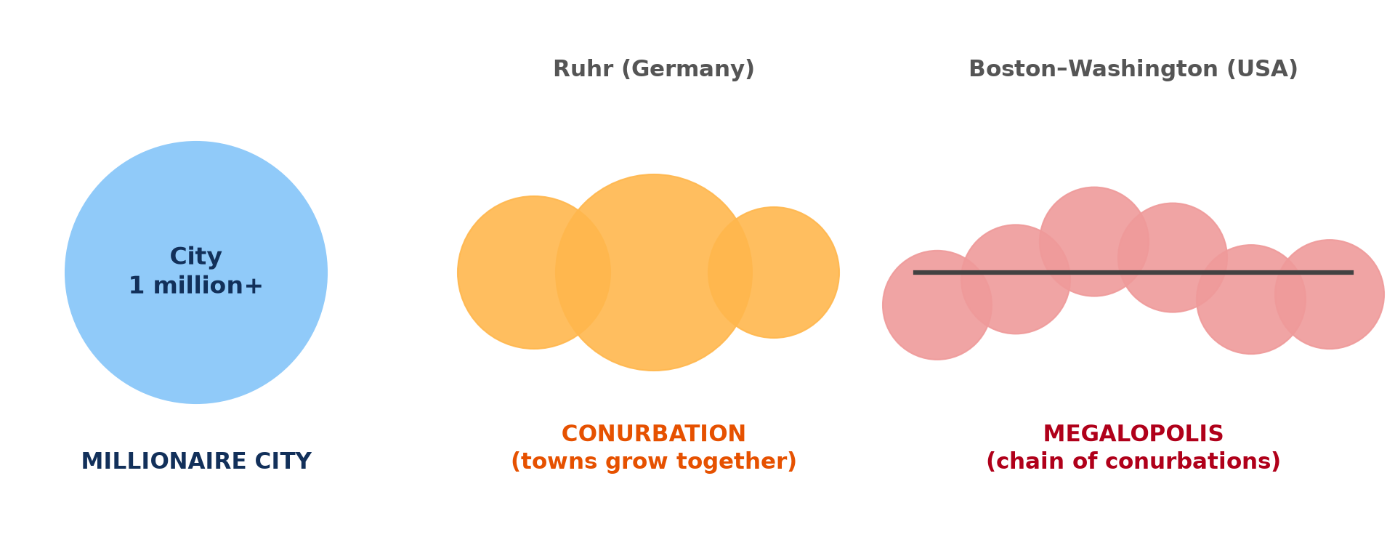
1. MEANING AND TYPES
Activity 1
Millionaire city, conurbation and megalopolis.
Notes:
Activity 1. Look carefully at this diagram: millionaire city, conurbation and megalopolis. Observe every detail before I ask the question.

Slide 19
1. MEANING AND TYPES
Activity 1: Question
What is a conurbation?
Notes:
Here is the question for Activity 1: What is a conurbation? Take one minute to think and write your answer in your rough notebook.

Slide 20
1. MEANING AND TYPES
Activity 1: Answer
Several towns that have grown together into one urban area.
Notes:
Let us check the answer together. Several towns that have grown together into one urban area.

Slide 21
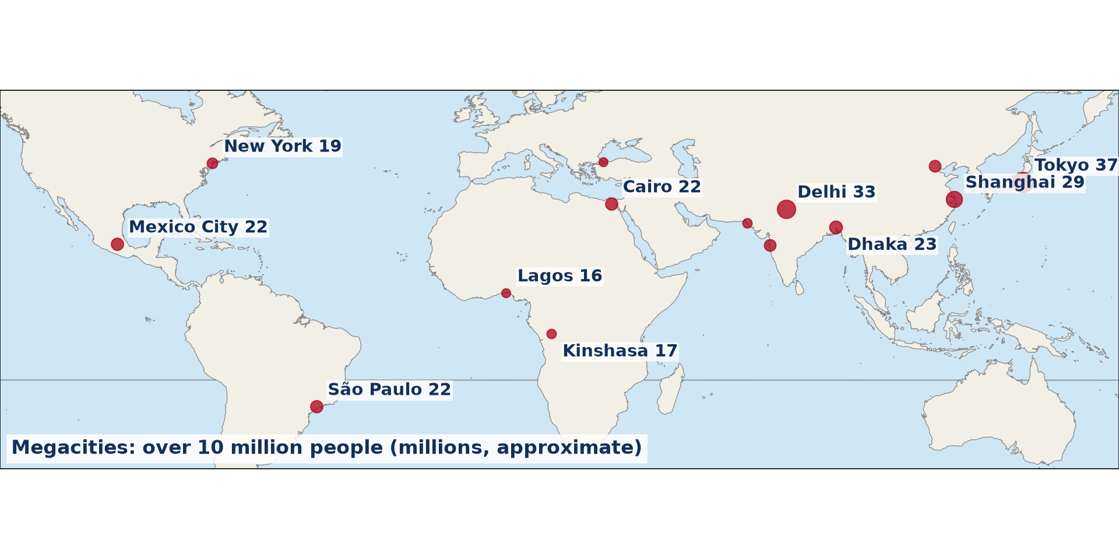
2. SPATIAL DISTRIBUTION
Activity 2
Megacities of the world (approximate).
Notes:
Activity 2. Look carefully at this diagram: megacities of the world (approximate). Observe every detail before I ask the question.

Slide 22
2. SPATIAL DISTRIBUTION
Activity 2: Question
In which continent are most megacities today?
Notes:
Here is the question for Activity 2: In which continent are most megacities today? Take one minute to think and write your answer in your rough notebook.

Slide 23
2. SPATIAL DISTRIBUTION
Activity 2: Answer
Asia.
Notes:
Let us check the answer together. Asia.

Slide 24
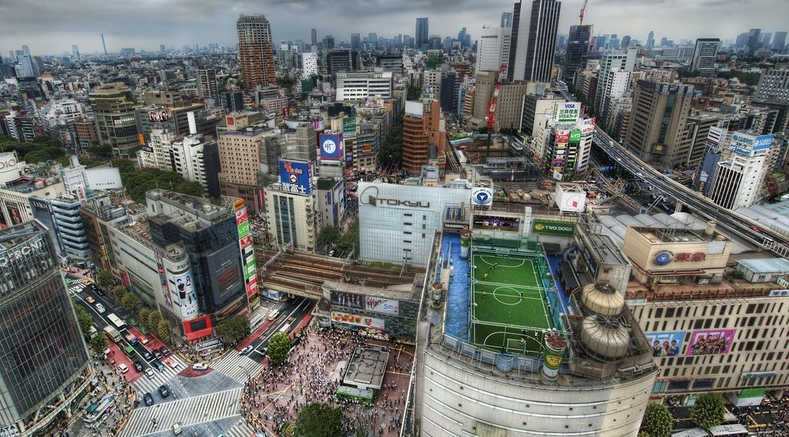
2. PROMINENT EXAMPLES
Activity 3
Tokyo from the air.
Notes:
Activity 3. Look carefully at this picture: tokyo from the air. Observe every detail before I ask the question.

Slide 25
2. PROMINENT EXAMPLES
Activity 3: Question
Why is Tokyo the largest urban region?
Notes:
Here is the question for Activity 3: Why is Tokyo the largest urban region? Take one minute to think and write your answer in your rough notebook.

Slide 26
2. PROMINENT EXAMPLES
Activity 3: Answer
It is a major centre of industry, finance and government with good transport.
Notes:
Let us check the answer together. It is a major centre of industry, finance and government with good transport.

Slide 27

3. CAUSES
Activity 4
A crowded market (Lagos region).
Notes:
Activity 4. Look carefully at this picture: a crowded market (Lagos region). Observe every detail before I ask the question.

Slide 28
3. CAUSES
Activity 4: Question
Why do African cities like Lagos grow so fast?
Notes:
Here is the question for Activity 4: Why do African cities like Lagos grow so fast? Take one minute to think and write your answer in your rough notebook.

Slide 29
3. CAUSES
Activity 4: Answer
Rural-urban migration and high natural increase.
Notes:
Let us check the answer together. Rural-urban migration and high natural increase.

Slide 30

3. PROBLEMS
Activity 5
Traffic in a big city.
Notes:
Activity 5. Look carefully at this picture: traffic in a big city. Observe every detail before I ask the question.

Slide 31
3. PROBLEMS
Activity 5: Question
Give two problems of megacities.
Notes:
Here is the question for Activity 5: Give two problems of megacities. Take one minute to think and write your answer in your rough notebook.

Slide 32
3. PROBLEMS
Activity 5: Answer
Congestion and slums (also pollution, water shortage).
Notes:
Let us check the answer together. Congestion and slums (also pollution, water shortage).

Slide 33
BOARD SUMMARY
Board Summary
Topic: Urban Settlement and Urbanisation
Sub-topic: Urban Growth
Lesson 13: Urban Regions: Millionaire Cities, Conurbations and Megalopolis
Notes:
Now we are going to copy the board summary. Write the title and the headings neatly in your notebooks. I will give you enough time for each slide, so do not rush.

Slide 34
BOARD SUMMARY
1. Meaning of Urban Regions
The main urban regions are defined as follows:
Millionaire city: It is a city with more than one million inhabitants. Douala and Yaoundé are millionaire cities.
Notes:
Let us copy Meaning of Urban Regions. The main urban regions are defined as follows. On this slide we have Millionaire city. Write each point on a new line, with the key term first, and explain it in your own words when we revise. When you finish, we go to the next slide.

Slide 35
BOARD SUMMARY
1. Meaning of Urban Regions (continued)
Conurbation: It is a large urban area formed when growing towns merge together. The Ruhr in Germany and Greater Lagos are examples.
Notes:
We continue with Meaning of Urban Regions. On this slide we have Conurbation. Write each point on a new line, with the key term first, and explain it in your own words when we revise. When you finish, we go to the next slide.

Slide 36
BOARD SUMMARY
1. Meaning of Urban Regions (continued)
Megalopolis: It is a very large chain of conurbations linked by transport, with tens of millions of people. BosWash (Boston–Washington) and Tokyo–Osaka are examples.
Notes:
We continue with Meaning of Urban Regions. On this slide we have Megalopolis. Write each point on a new line, with the key term first, and explain it in your own words when we revise.

Slide 37
BOARD SUMMARY
1. Meaning of Urban Regions
Illustration: types of urban regions
Notes:
Now draw this illustration in your notebook: types of urban regions. Give it a title and label it clearly.

Slide 38
BOARD SUMMARY
2. Spatial Distribution and Causes
Urban regions are distributed and caused as follows:
Distribution: Most megacities (over 10 million) are now in Asia, such as Tokyo, Delhi and Shanghai. Africa has Lagos, Cairo and Kinshasa.
Notes:
Let us copy Spatial Distribution and Causes. Urban regions are distributed and caused as follows. On this slide we have Distribution. Write each point on a new line, with the key term first, and explain it in your own words when we revise. When you finish, we go to the next slide.

Slide 39
BOARD SUMMARY
2. Spatial Distribution and Causes (continued)
Causes: Industrialisation, trade, rural–urban migration and natural increase make cities grow. Good transport links join towns into conurbations.
Problems: Megacities suffer from traffic congestion, slums, pollution and water shortages. They are difficult to govern.
Notes:
We continue with Spatial Distribution and Causes. On this slide we have Causes and Problems. Write each point on a new line, with the key term first, and explain it in your own words when we revise.

Slide 40
BOARD SUMMARY
2. Spatial Distribution and Causes
Illustration: megacities of the world
Notes:
Now draw this illustration in your notebook: megacities of the world. Give it a title and label it clearly.

Slide 41
FORMATIVE EVALUATION
Evaluation 1
Distinguish a conurbation and a megalopolis.
Notes:
Now let us check what you have understood. Question 1: Distinguish a conurbation and a megalopolis. Answer in your exercise book.

Slide 42
FORMATIVE EVALUATION
Expected Answer
A conurbation is towns grown together; a megalopolis is a chain of conurbations.
Notes:
The expected answer is: a conurbation is towns grown together; a megalopolis is a chain of conurbations. If you got it right, well done.

Slide 43
FORMATIVE EVALUATION
Evaluation 2
Give two megacities and their continents.
Notes:
Now let us check what you have understood. Question 2: Give two megacities and their continents. Answer in your exercise book.

Slide 44
FORMATIVE EVALUATION
Expected Answer
Tokyo (Asia) and Lagos (Africa) (also São Paulo, Mexico City).
Notes:
The expected answer is: tokyo (Asia) and Lagos (Africa) (also São Paulo, Mexico City). If you got it right, well done.

Slide 45
REMEDIATION
Remediation
Fill in the blanks:
A city with over 10 million people is a ______.
Towns grown together form a ______.
Boston–Washington is a ______.
Notes:
For those who need more practice, fill in the blanks in your exercise book. The answers are: number 1, megacity; number 2, conurbation; number 3, megalopolis.

Slide 46
HOMEWORK
Homework
Name five megacities and mark them on a world map.
Notes:
For your homework: Name five megacities and mark them on a world map. We shall correct it at the beginning of our next lesson.

Slide 47
NEXT LESSON
Next Lesson
Our next lesson will be on:
Lesson 14: Urban Fields (Spheres of Influence)
Notes:
Our next lesson will be on Lesson 14: Urban Fields (Spheres of Influence). Thank you for your attention, and see you next time.

Slide 48
BILINGUAL GAME
Bilingual Game (Jeu Bilingue)
English | Français
Megacity | La mégapole
Conurbation | L'agglomération (conurbation)
Megalopolis | La mégalopole
Million | Le million
Corridor | Le corridor
Growth | La croissance
Notes:
Let us play the bilingual game. I say a word in English, and you give me the French word. Then we do the reverse.

Slide 49
LOGBOOK
Official Logbook (1/2)
Module / Topic | Urban Settlement and Urbanisation
Lesson Title | Lesson 13: Urban Regions: Millionaire Cities, Conurbations and Megalopolis
Expected Learning Outcomes | Define millionaire city, conurbation and megalopolis. Describe their world distribution. Explain the causes of their growth.
Competence | Learners are able to describe very large urban regions and explain their growth.
Notes:
I record this information in the official logbook of the class after the lesson.

Slide 50
LOGBOOK
Official Logbook (2/2)
Matter Taught | Meaning of Urban Regions; Spatial Distribution and Causes.
Evaluation | Formative evaluation and remediation exercise.
Homework | Name five megacities and mark them on a world map.
Enrolment / Present / Absent | ____ / ____ / ____
Achievement | To be completed after the lesson.
Notes:
I complete the second page of the logbook: the matter taught, the evaluation, the homework and the attendance.

Slide 51
TEACHER'S NOTE
Teacher's Note
Timing: Homework correction, plan, objectives 8 min | Recall, situation, action 10 min | 5 activities 30 min | Board summary (copying) 30 min | Evaluation, remediation 10 min | Homework, next lesson 5 min | Logbook 7 min
Without the projector (Activity 1): draw the three forms.
Without the projector (Activity 2): find the megacities on a map.
Without the projector (Activity 3): find Tokyo.
Without the projector (Activity 4): compare Lagos and Douala.
Without the projector (Activity 5): list problems.
Notes:
This slide is for me, the teacher: it gives the timing of the lesson and what to do if the projector is not available.

Slide 52
REFERENCES
References
National Geography Syllabus, MINESEC/IGE/IP-SS, 2019 — Module 5 (Settlement Geography).
Photo, Activity 3: “Tokyo from the Air” by Trey Ratcliff, CC BY-NC-SA 2.0, via Flickr (https://www.flickr.com/photos/95572727@N00/4140101118)
Photo, Activity 4: “Wax market” by zouzouwizman, CC BY 2.0, via Flickr (https://www.flickr.com/photos/61111202@N00/12129001)
Photo, Activity 5: “Nairobi Traffic Jam” by rogiro, CC BY-NC 2.0, via Flickr (https://www.flickr.com/photos/43132185@N00/48712135)
Diagrams and animations: drawn for this lesson (Geography Department).
Notes:
These are the references and picture credits used to prepare this lesson.

